Slide 1



OUR ATM, YOUR LIBERTY TO ENCASH
NCR Hackathon 2023
Currency Codebreakers

Slide 2

What’s the problem around?
ATM Merchant
How to determine cash requirements?
How to achieve operational efficiency?
How to minimize congestion?
How to optimize customer engagement?
How to increase profits?
Customer
When I visit the ATM - will there be sufficient fund?
What are the services at my nearest ATM?
How can I find best ATM for me?
HOW MANAGE CASH?

Slide 3


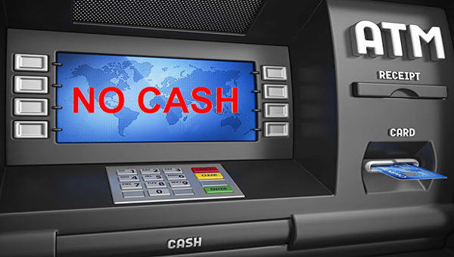

CashShield Pro+
RESERVE CASH
Reserve cash at ATM’s and visit on convenience
LOW/NO CASH
Ensure transaction balance at ATM before visit
HAPPY HOURS
Visit ATM during happy hours and avail discounts

Slide 4
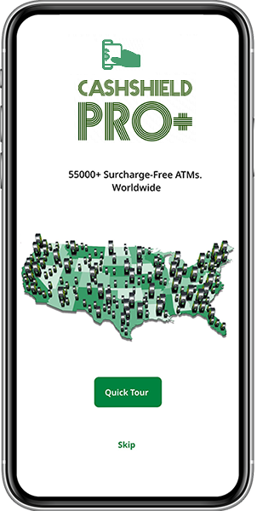
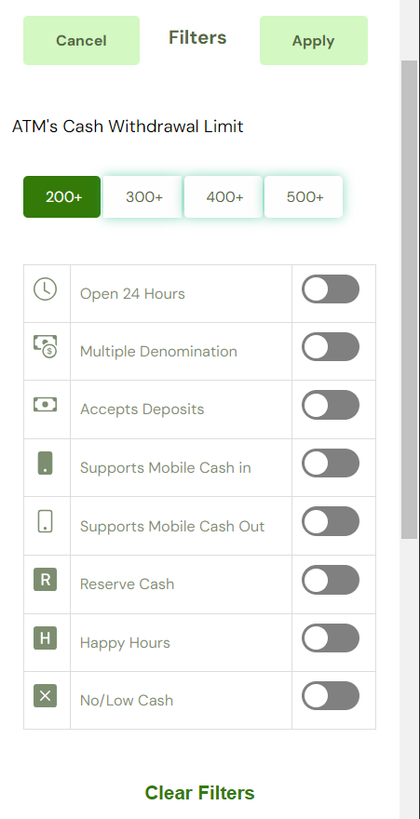
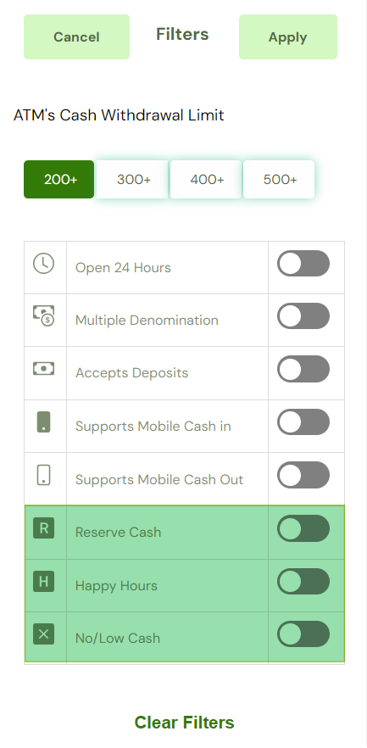
How it works?

Slide 5
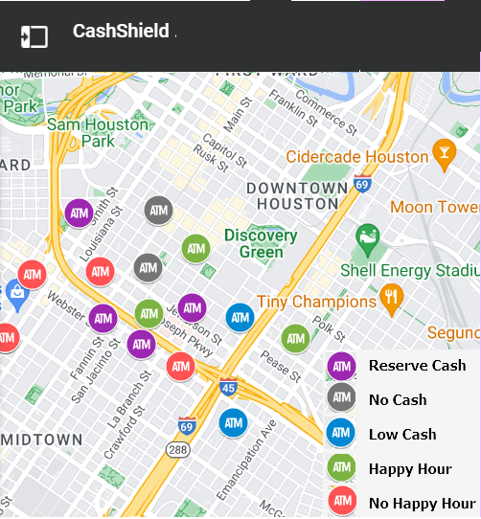
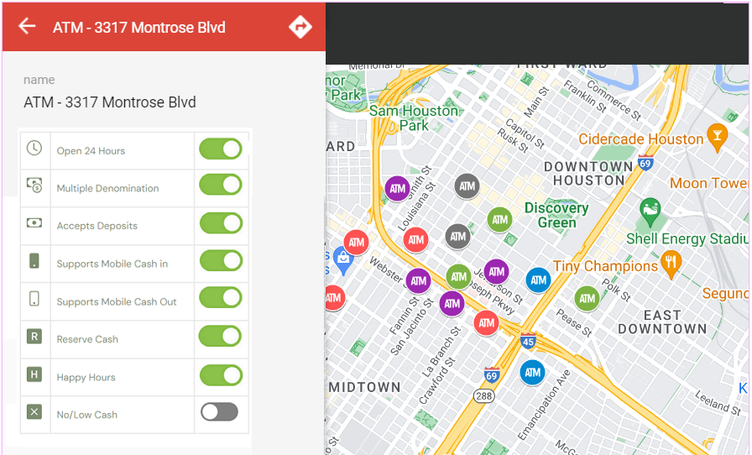
Reserve Cash…

Slide 6
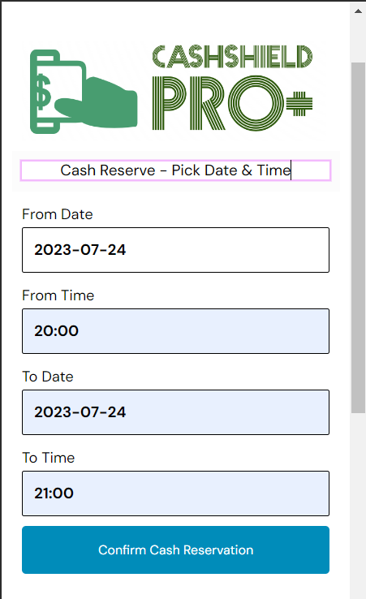
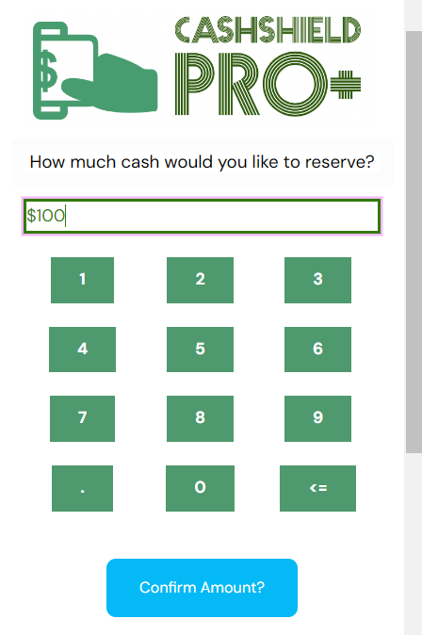
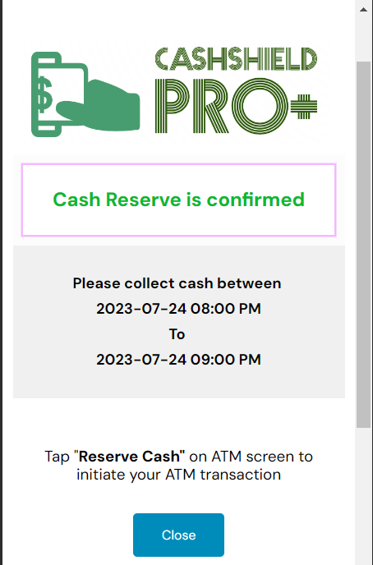
Reserve Cash…

Slide 7
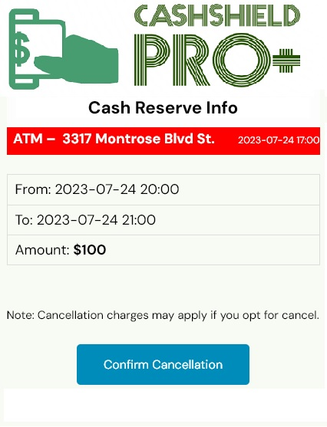
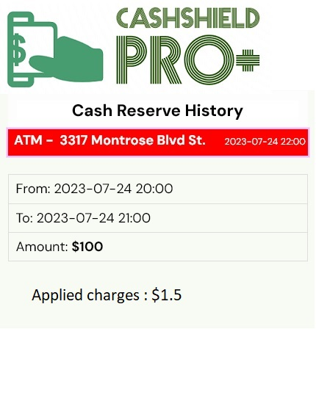
Cash Reserve Cancellation

Slide 8
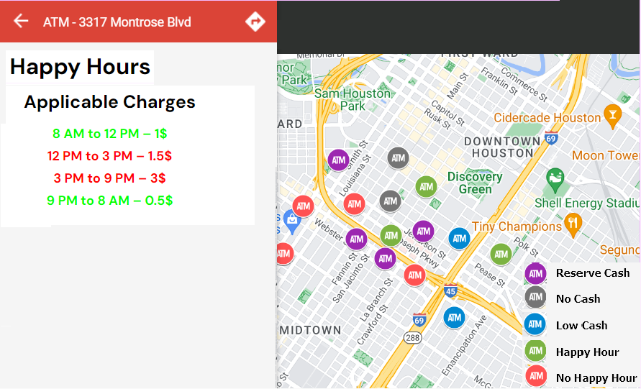
Happy Hours

Slide 9
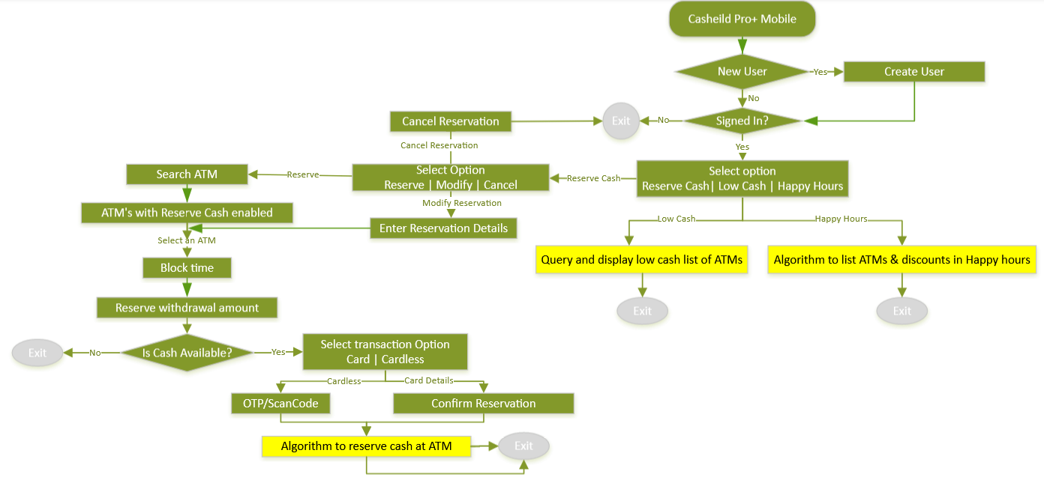
Process Flow…

Slide 10


ATM Merchant
Increased Cash Flow during Happy Hours
Reduction on stagnant cash ATMs
NCR
Additional revenue by Convenience Charge on Reserve Cash
Meets ‘Customer First’ moto by having ‘Happy Customers’ with all the info on their ATM transactions
Customer
Mitigate the risk of encountering low or no cash situations in ATMs
Immediate access to emergency funds whenever required
Secure a specific amount of cash in an ATM for a designated period
Reserving cash allows customers to determine the amount and duration of the reservation, offering them flexibility based on their specific financial requirements.

Slide 11
Future Enhancement Integrating Reserve Cash, Low/No Cash and Happy Hours features to All-Point Mobile Integrating the Reserve Cash feature to NCR Pay 360

Slide 12



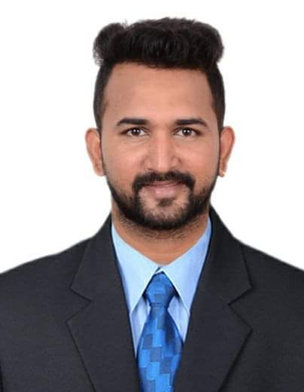
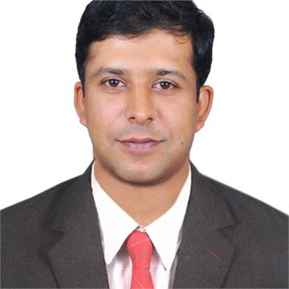


Meet Our Team
Shivaraj Jogi
Roopalaxmi Pedamale
Jagadeesha Salian
Dileep Kumar
Sandeep Shiranthadka
Nireeksha Jayananda
Pradeep Murgaje

Slide 13


